Slide 1
Warm up
What was the last good that you bought? How much did it cost? Describe your thought process as you bought this good.

Slide 2
Price System
Total Revenue
Demand
Supply
Elasticity

Slide 3
Objective
Students will….
Examine the interaction of supply, demand and price
Students will be able to…
Explain the effect of changes in price on the quantity
demanded and quantity supplied (2A)
Identify the non-price determinants that create
change in supply and demand which result in a new
equilibrium price (2B)
Interpret a supply and demand graph (2AC)

Slide 4
DEMAND
Demand - amount of a product that consumers are WILLING and ABLE to buy at every price point.
The desire to own something and the ability to pay for it.

Slide 5
Law of Demand
Price goes
DOWN
Quantity demanded goes UP
Quantity demanded goes down.
Price goes
UP

Slide 6
Substitution Effect
What would you do if Whataburger doubled their prices while McDonald’s and Chipotle kept theirs the same?

Slide 7
2 Effects that that result in the Law of Demand...
Substitution effect
and
Income effect

Slide 8
Substitution Effect
When consumers react to an increase in a good’s price by consuming less of that good and more of the other goods.
Ex: Whataburger has gotten too expensive, I’ll buy McDonald’s instead.

Slide 9
Income Effect
The original 1967 Camaro cost around $2,500.
The 2014 Camaro costs around $24,000.
If the Camaro cost only $ 2,500 would consumers buy more than 1?
What would consumers do with the leftover $21, 500?

Slide 10
Income Effect
the change in consumption resulting from a change in real income.
Ex: If the price of an item you normally purchase goes up you will buy less of it or something else.
Ex: If the price goes down you may buy more of it or more of something else.

Slide 11
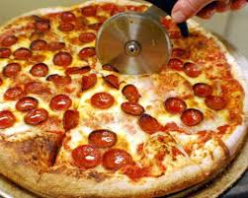
How many slices of pizza would you buy?
Demand Schedule
Individual
Market (This class)
Price of a slice of pizza | Quantity demanded per day | Price of a slice of pizza | Quantity demanded per day
$.50 |  | $.50
$1.00 |  | $1.00
$1.50 |  | $1.50
$2.00 |  | $2.00
$2.50 |  | $2.50
$3.00 |  | $3.00

Slide 12
Demand Schedule
Individual demand schedule
Market Demand Schedule
Price of a slice of pizza | Quantity demanded per day | Price of a slice of pizza | Quantity demanded per day
$.50 | 5 | $.50 | 300
$1.00 | 4 | $1.00 | 250
$1.50 | 3 | $1.50 | 200
$2.00 | 2 | $2.00 | 150
$2.50 | 1 | $2.50 | 100
$3.00 | 0 | $3.00 | 50
Lists the quantity of a good all consumers would buy at each different price

Slide 14
Marginal Utility
Utility - usefulness or satisfaction you get from a good.
Marginal Utility - Extra satisfaction you get from 1 more unit of that good.
Law of diminishing Utility - Utility we get from extra units of a product will eventually decrease

Slide 15
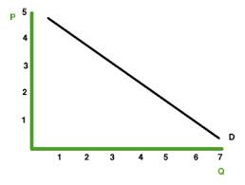
The Demand Graph (curve)
Shows quantity of a good demanded at each price level

Slide 16
As Price of good increases then quantity demanded decreases.
As Price of good decreases then quantity demanded increases.

Slide 17
Using our Demand Schedule…..
Draw a Demand Graph.
Price
Quantity

Slide 18
Law of Quantity Demanded
1. As Price of good increases then quantity demanded decreases.
2. As Price of good decreases then quantity demanded increases.

Slide 19
Determinants of Demand
Factors that decide where the curve is:
1. Consumer Tastes - Consumers like goods more = DEMAND
2. Population - Number of Consumers goes up = DEMAND
3. Income -Consumers income rises = DEMAND

Slide 20
Determinants of Demand cont...
4. Substitute Goods
a. Goods that can replace another good.
b. If a goods price increases - demand for its substitute increases. If a goods price decreases, demand for its substitute decreases.
5. Complementary Goods
a. Popularity of one good causes demand for another good to increase
Ex: Ipads + Ipad apps
b. If a complementary good price goes up demand for its compliment decreases

Slide 21
Determinants of Demand cont...
6. Consumer Expectations
If you expect or know the price of a good is going up next week then your demand may go up to buy good today.
If you expect or know that a good will go on sale your demand may go down until it goes on sale.
If people feel economy is going well or a good might be more expensive in future, demand for good increase.

Slide 22
Changes
Change in price = change in quantity demanded.
Changes to “determinants of demand” cause demand curve to SHIFT LEFT or RIGHT

Slide 23
Questions
Explain why the law of demand can only apply in a free market economy
Define income effect and substitution effect

Slide 24
Warm Up
List and explain the Determinants of Demand
Review questions from last lesson

Slide 25
Elasticity of Demand
A measure of how consumers react to a change in price.
Elastic - describes demand that is very sensitive to a change in price
You buy much less of a good b/c of a small price change
Inelastic - describes demand that is not very sensitive to a change in price
You still buy the good even after price increase

Slide 26
Why is it important to understand Elasticity?
Helps measure how consumers respond to price changes.
Important for businesses to see how change in prices will affect their total revenue.
Total Revenue - the total amount of money a firm receives by selling goods and services.

Slide 27
Calculating Total Expenditures
Multiply the price of the product by the quantity demanded for any point on a curve.
Price x Quantity demanded = Total Expenditures

Slide 28
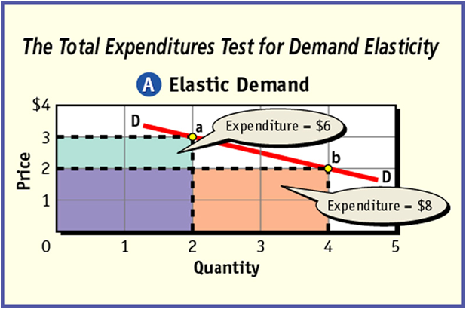
•If total expenditures and price move in opposite directions, demand is elastic
•Or, if a change in price causes a relatively large change in the quantity demanded, demand is elastic

Slide 29
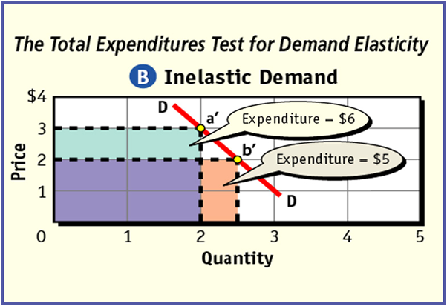
•If total expenditures and price move in same direction, demand is inelastic
•Or, if a change in price causes a relatively smaller change in quantity demanded, demand is inelastic

Slide 30
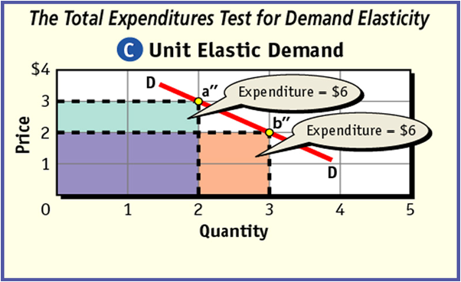
•If there is no change in total expenditures when the price changes, demand is unit elastic.
•Or, if a change in price causes a proportional change in quantity demanded

Slide 31
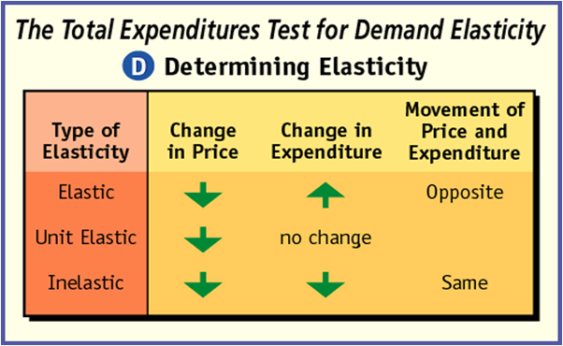
•The key to determining elasticity is to examine how total expenditures change when the price changes.

Slide 32
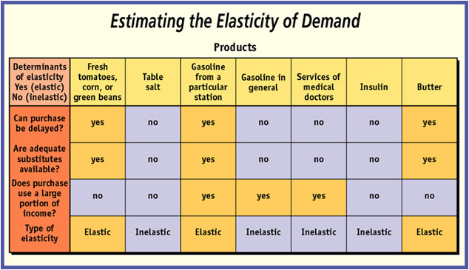

Slide 33
Determining Elasticity
The elasticity of demand can usually be estimated by examining the answers to three key questions:
1.Can purchase be delayed?
2.Are adequate substitutes available?
3.Does purchase use large portion of income?
All three answers do not have to be the same in order to determine elasticity
In some cases the answer to a single question is so important that it alone might dominate the answers to the other two questions.

Slide 34
Determinants of Demand Elasticity
Availability of Substitutes - If there are little or no substitutes for a good then you might still buy it because there are no good alternatives. If there are many substitutes for a good then you will buy the substitutes instead.
Can you think of an example?

Slide 35
Determinants of Demand Elasticity
Relative Importance - How much of your budget do you spend on a good. Can you take a price increase?
Can it be delayed?
Come up with an example

Slide 36
Determinants of Demand Elasticity
Necessities vs Luxuries - differs from person to person. The consumer must decide if a good is a necessity or a luxury.
Come up with an example.

Slide 37
Change over time
Change over Time - when prices change, consumers often need time to react. So at first a good may be inelastic and then gradually becom elastic.

Slide 38
Questions
In your own words explain elasticity.
Why is demand for home heating fuel inelastic in cold weather?

Slide 39
Study for quiz

Slide 40
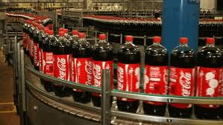
SUPPLY

Slide 41
Supply
The amount of good available.

Slide 42
The Law of Supply
As Price Increases
Quantity supplied increases
Quantity supplied decreases
As Price Decreases

Slide 43
Supply Schedule
Individual Supply Schedule
Price per slice of Pizza | Slices supplied per day
$.50 | 100
$1.00 | 150
$1.50 | 200
$2.00 | 250
$2.50 | 300
$3.00 | 350

Slide 44
Market Supply Schedule
Price per slice of Pizza | Slices supplied per day
$.50 | 1000
$1.00 | 1500
$1.50 | 2000
$2.00 | 2500
$2.50 | 3000
$3.00 | 3500
Shows the relationship between prices and the total quantity supplied by all businesses in a particular market.
The information in a market supply schedule becomes important when we want to determine the total supply of pizza at a certain price in a large area like a city.

Slide 45
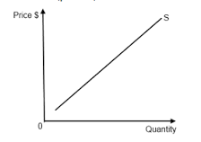
Supply Curve (graph)

Slide 46
Using the Supply Schedule below draw a Supply Graph
Price per slice of Pizza | Slices supplied per day
$.50 | 100
$1.00 | 150
$1.50 | 200
$2.00 | 250
$2.50 | 300
$3.00 | 350

Slide 47
Determinants for change in Supply
Cost of Inputs - A change in cost of inputs.
If the cost for labor and packaging goes down then producers will try to supply more.
If the cost for labor and packaging goes up then producers will supply less

Slide 48
Determinants for change in Supply
Productivity - If worker work harder because of good training or incentives then there will be an increase in supply
If workers work less hard because of poor training or poor leadership then there will be decrease in supply.

Slide 49
Determinants for change in Supply
Technology - New technology can improve production or lower costs and therefore increase supply.
Poor technology could slow production down or increase costs and therefore decrease supply.

Slide 50
Determinants for change in Supply
Taxes and subsidies - Taxes are considered part of the cost for production. An increase in taxes will decrease supply while a Tax decrease will increase supply.
A subsidy is a government payment to a individual or business to encourage or protect a certain type of economic activity.

Slide 51
Determinants for change in Supply
Expectations - If producers expect the price of their product to go up and demand to go down then they may decrease the supply
If producers expect the price of their product to go down then they may increase the supply

Slide 52
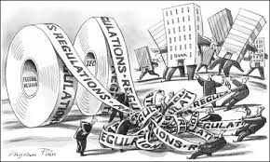
Determinants for change in Supply
Government Regulations - more government regulation usually slows down production and supply
Number of sellers - More suppliers = more supply. Less suppliers = less supply

Slide 53
Elasticity of Supply
Same as elasticity of demand
Measures the way suppliers respond to a change in price.
Elastic
Inelastic
Unitary

